Slide 1
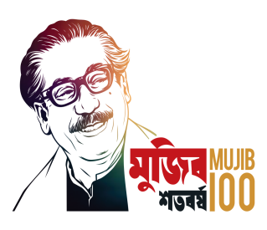
BANGLADESH TECHNICAL EDUCATION BOARD
DIPLOMA IN ENGINEERING
POWER TECHNOLOGY
4 th semester
Subject: IC Engine Details (27141)
Md. Naimur rahman
JUNIOR INSTRUCTOR
POWER TECHNOLOGY
Sylhet polytechnic institute, stlhet
Lesson 03

Slide 2
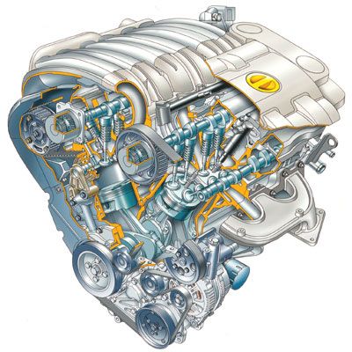
Features of IC engines

Slide 3
Internal Combustion Engines
types of heat engines
steam engines
external combustion
turbines
Stirling engine
Otto engine
internal combustion
Diesel engine
Vankel engine

Slide 4
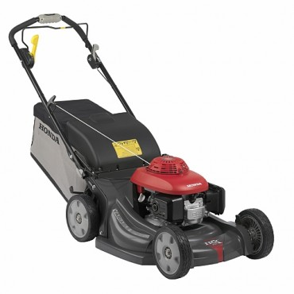
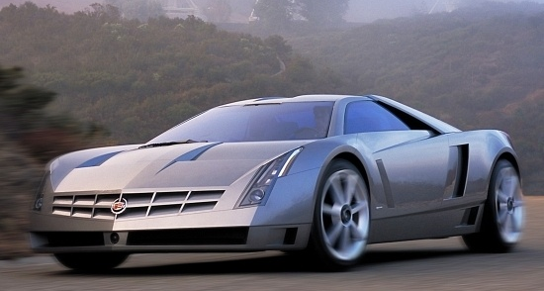
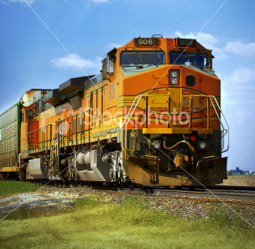
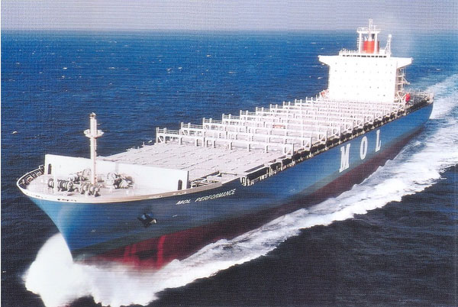
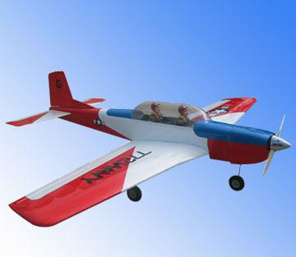
Internal Combustion Engines
The internal combustion engine is an engine in which the combustion of fuel-oxidizer mixture occurs in a confined space
applied in:
automotive
rail transportation
power generation
ships
aviation
garden appliances

Slide 5
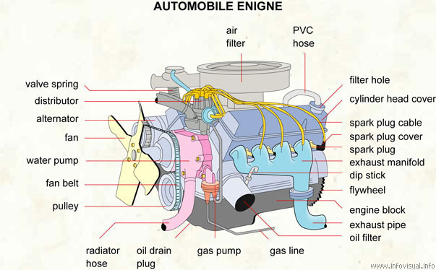
Internal Combustion Engines

Slide 6
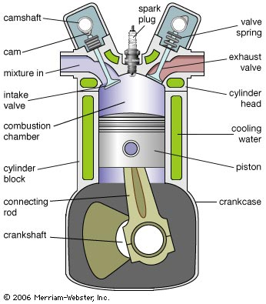
Internal Combustion Engines

Slide 7
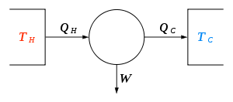
Internal Combustion Engines – Theorem Carnot cycle -
Carnot's theorem is a formal statement of this fact: No engine operating between two heat reservoirs can be more efficient than a Carnot engine operating between those same reservoirs.

Slide 8
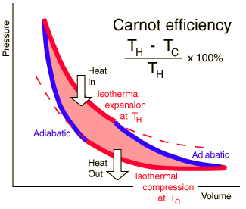
Internal Combustion Engines – Carnot cycle -
TH is the absolute of cold reservoir
TC is the absolute of hot reservoir

Slide 9
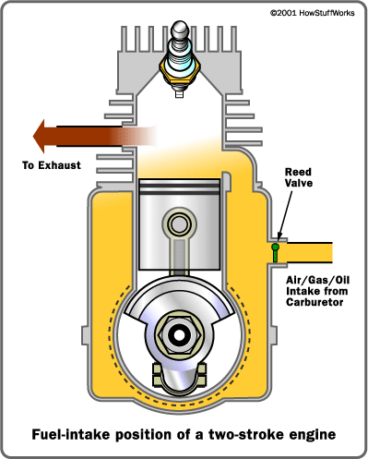
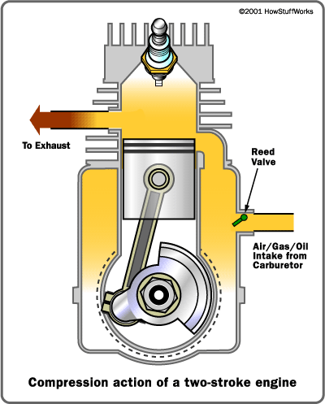
Internal Combustion Engines – two stroke -
1. Power / Exhaust
2. Intake / Compression
ignition
piston moves downward compressing fuel-air mixture in the crankcase
exhaust port opens
inlet port opens
compressed fuel-air mixture rushes into the cylinder
piston upward movement provides further compression

Slide 10
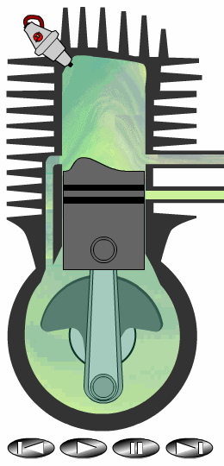
Internal Combustion Engines – two stroke -
Advantages:
lack of valves, which simplifies construction and lowers weight
fire once every revolution, which gives a significant power boost
can work in any orientation
good power to weight ratio
Drawbacks:
lack of a dedicated lubrication system makes the engine to wear faster.
necessity of oil addition into the fuel
low efficiency
produce a lot of pollution

Slide 11
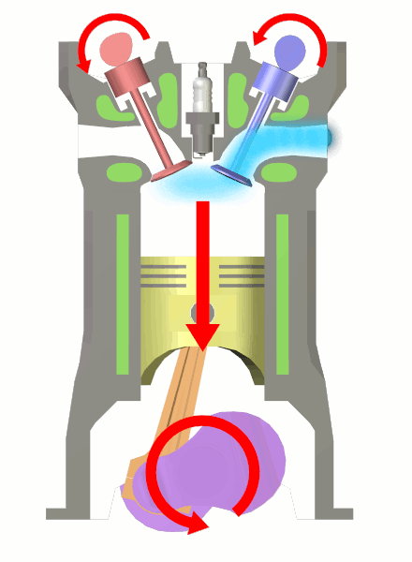
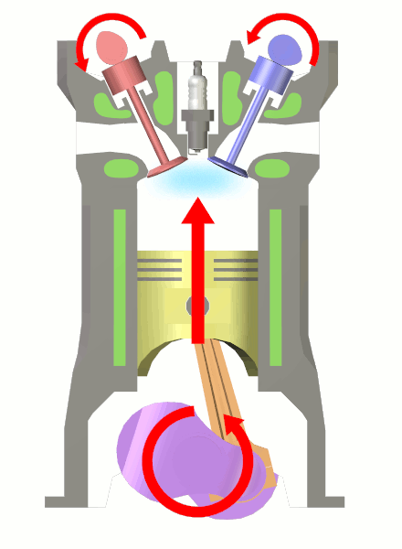
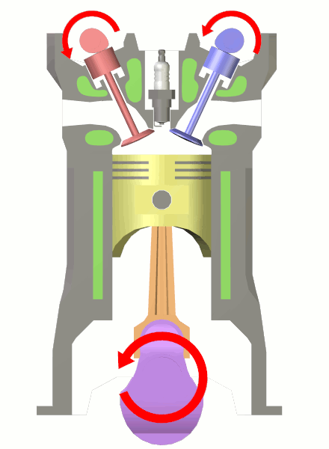
Internal Combustion Engines – four stroke -
1. intake
2. compression
starting position
a. piston starts moving down
b. intake valve opens
c. air-fuel mixture gets in
a. piston moves up
b. both valves closed
c. air-fuel mixture gets compressed

Slide 12
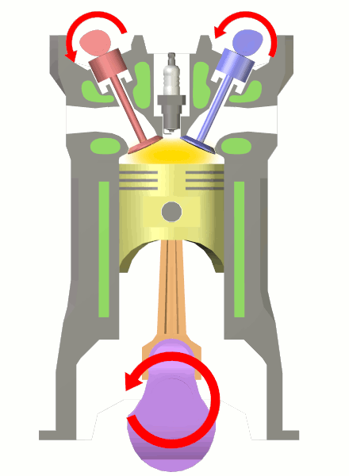
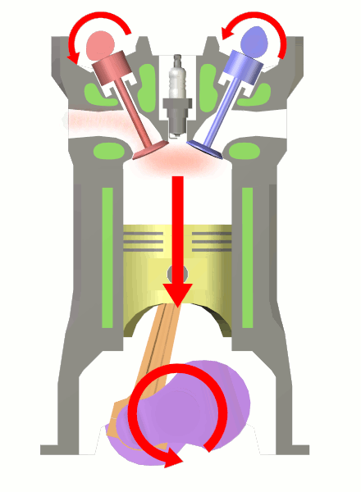
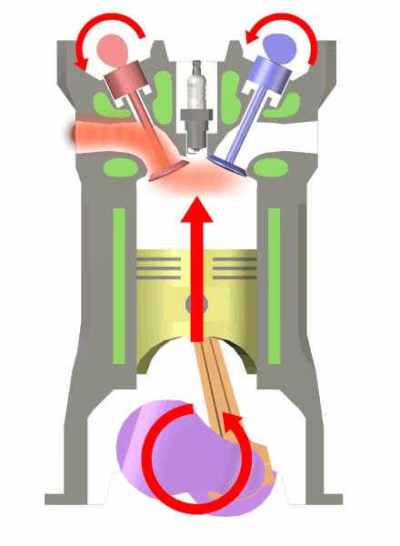
Internal Combustion Engines – four stroke -
ignition
3. power
4. exhaust
a. air-fuel mixture explodes driving the piston down
a. piston moves up
b. exhaust valve opens c. exhaust leaves the cylinder

Slide 13
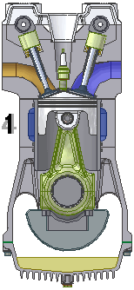
Internal Combustion Engines – four stroke -
Advantages:
dedicated lubrication system makes to engine more wear resistant
better efficiency that 2-stroke engine
no oil in the fuel – less pollution
Drawbacks:
complicated constriction
should work in horizontal position due to lubrication

Slide 14
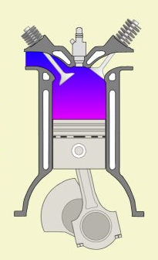
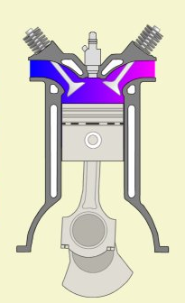
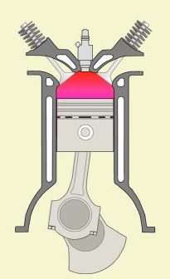
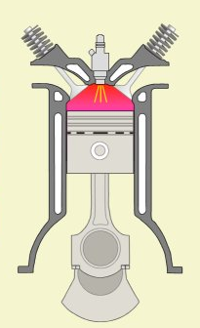
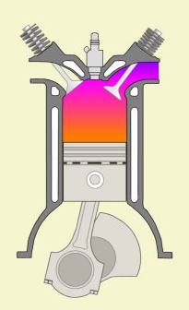
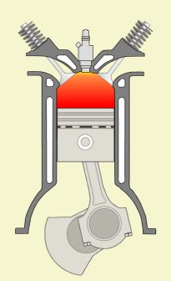
Internal Combustion Engines – four stroke -
air intake
exhaust /intake
compression
fuel injection
exhaust
combustion

Slide 15
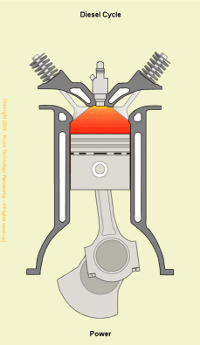
Internal Combustion Engines – Diesel -
Advantages:
self ignition (without electrical spark plug)
better efficiency
reliability
higher durability
supplied with worse fuels
Drawbacks:
more expensive production
more weight
louder
lower revolutions

Slide 16
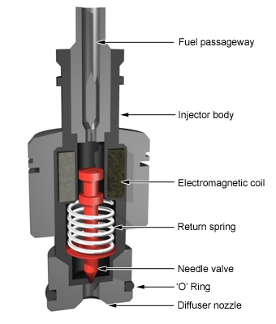
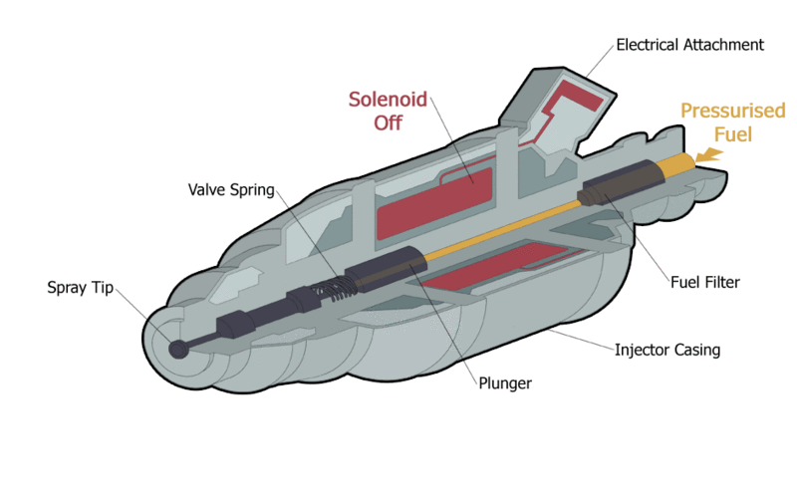
Internal Combustion Engines – Diesel -

Slide 17
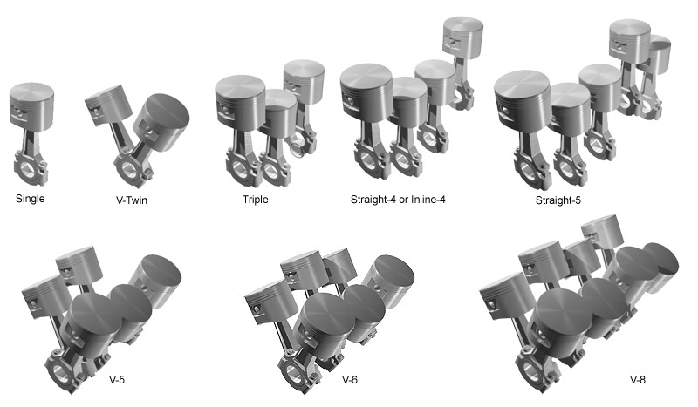
Internal Combustion Engines – multi-cylinder -
Cylinder layouts

Slide 18
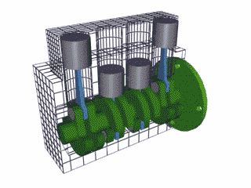
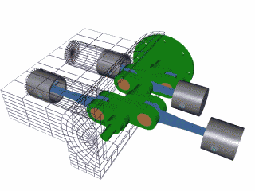
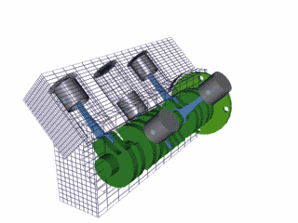
Internal Combustion Engines – multi-cylinder -
Cylinder layouts
inline
flat
V TYPE

Slide 19
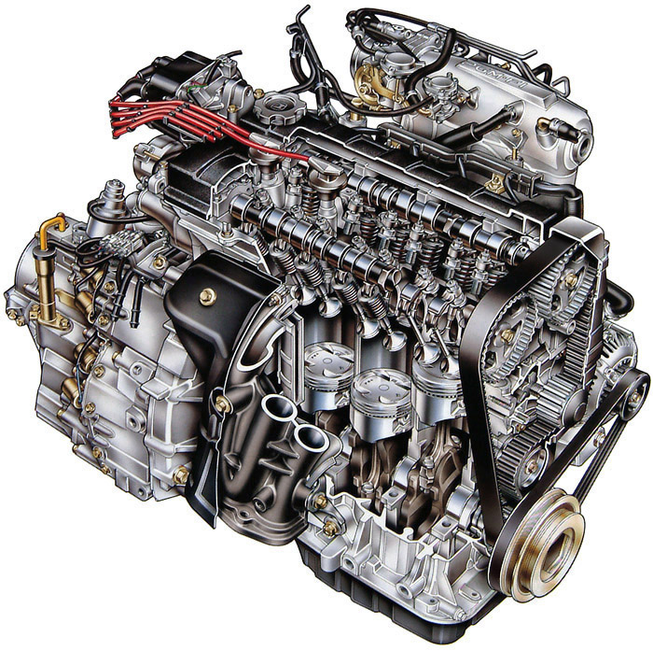
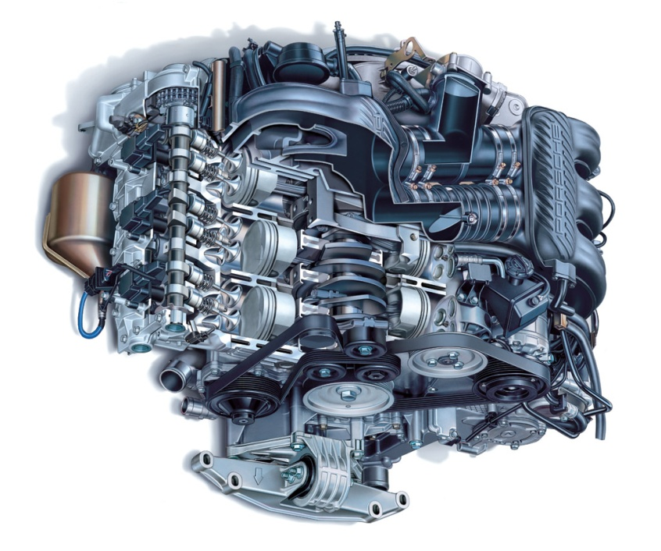
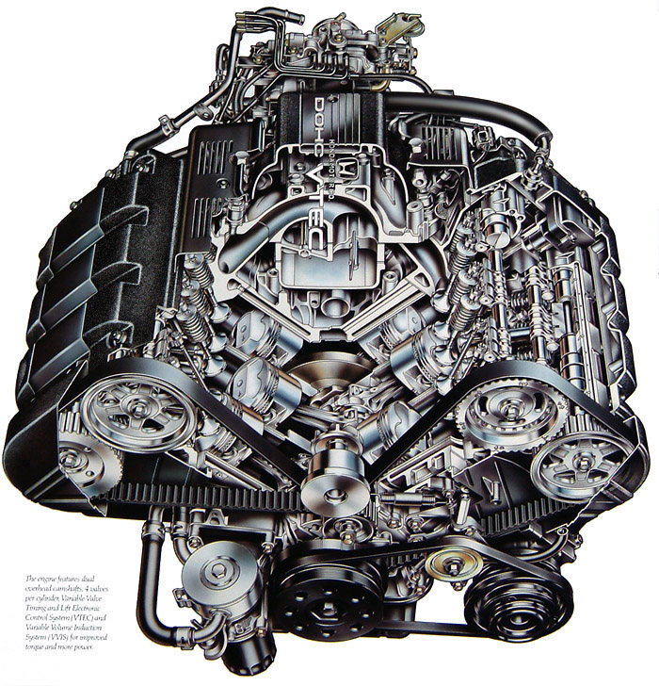
Internal Combustion Engines – multi-cylinder -
inline
flat
„boxer”
V

Slide 20
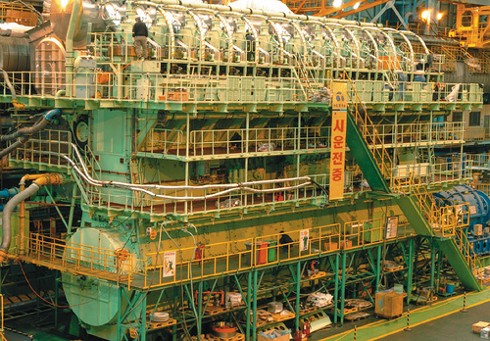
Internal Combustion Engines – multi-cylinder -
14 cylinder Diesel engine (80 MW)

Slide 21
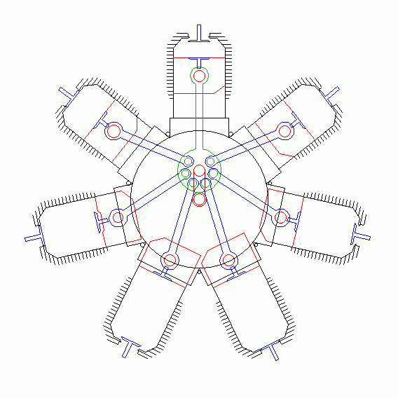
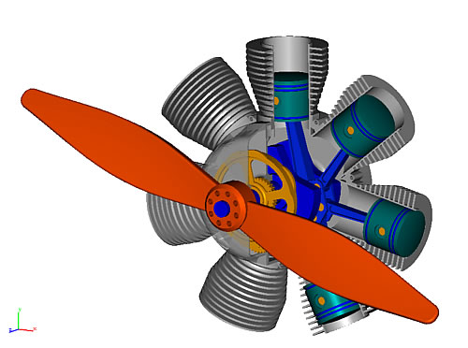
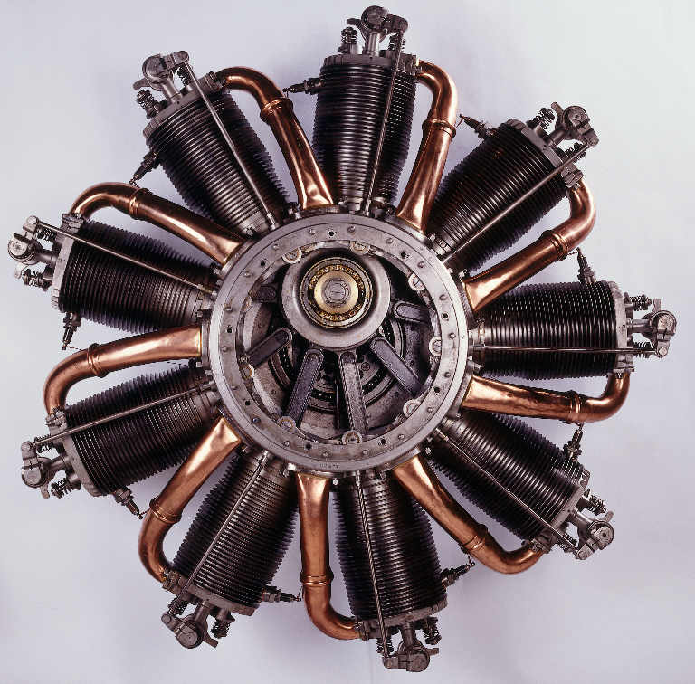
Internal Combustion Engines – multi-cylinder -
Cylinder layouts
radial

Slide 22
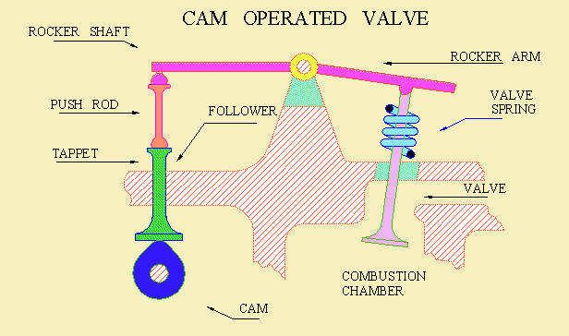
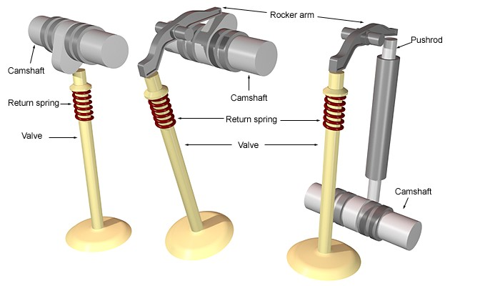
Internal Combustion Engines
Valve operation

Slide 23
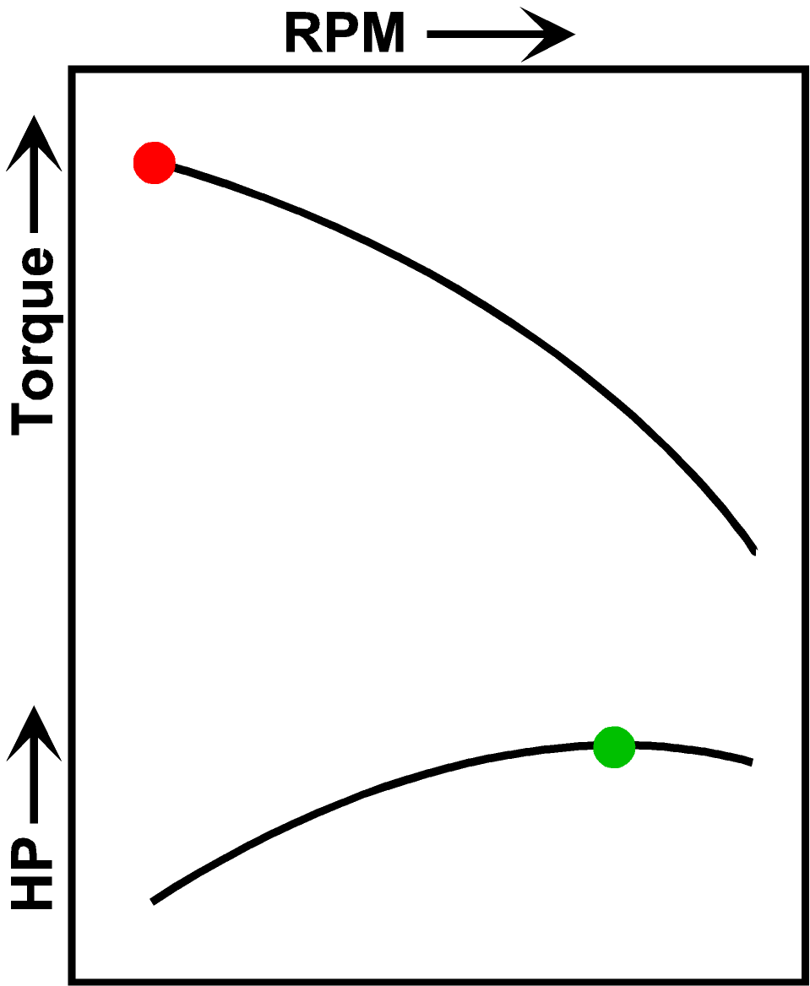
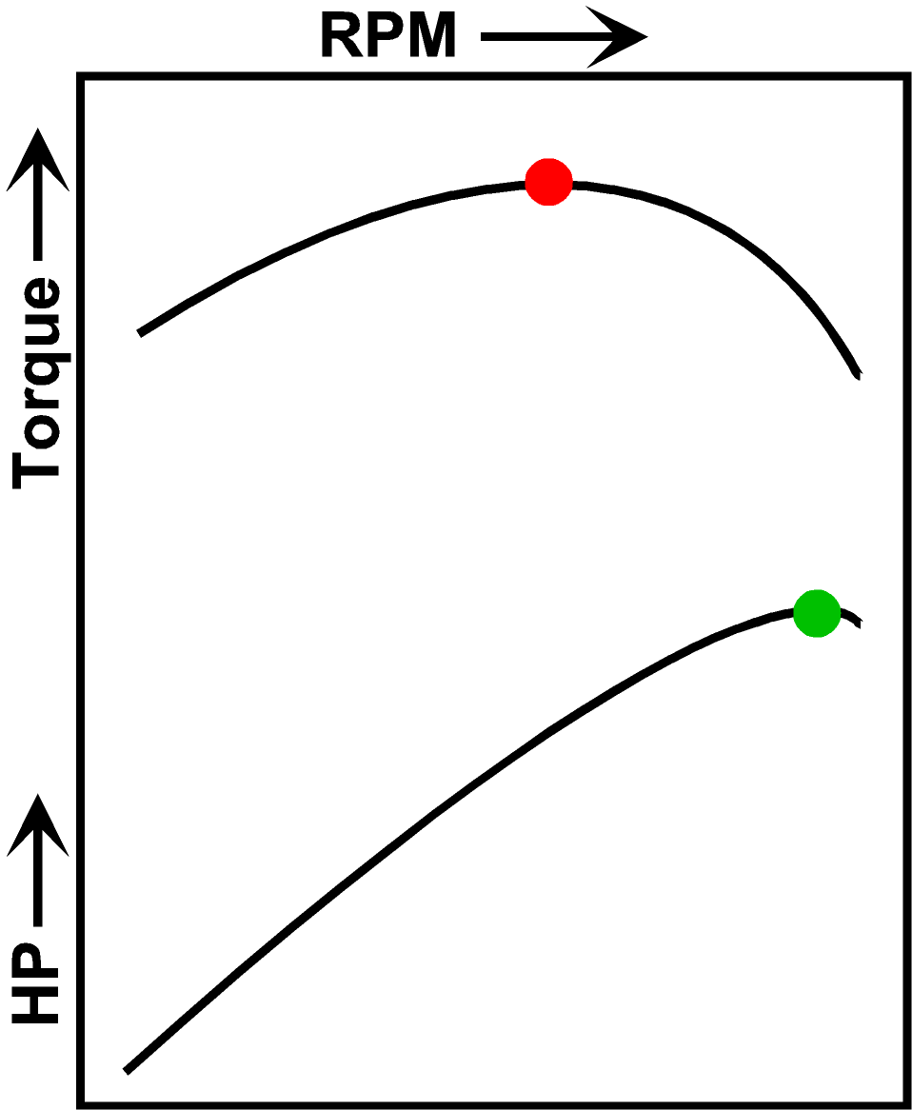
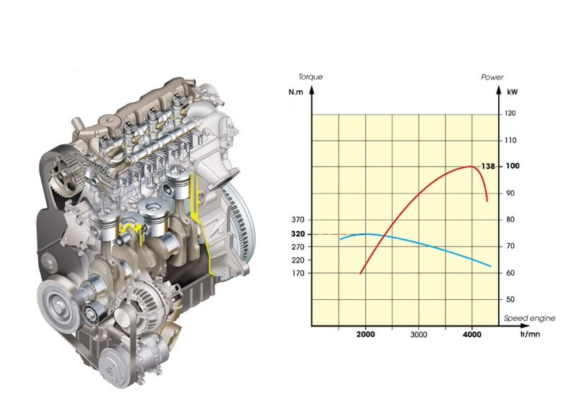
Engine characteristic
Diesel
Petrol

Slide 24
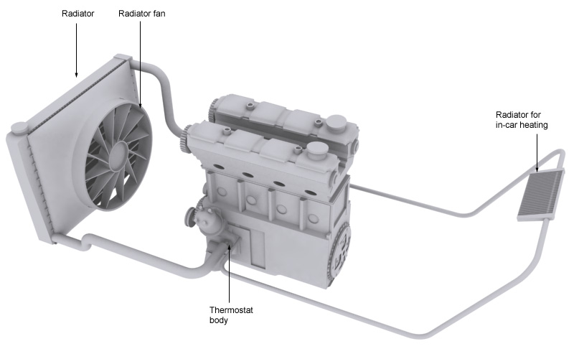
Internal Combustion Engines
Engine cooling

Slide 25
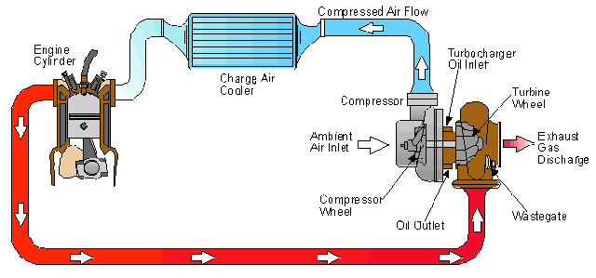
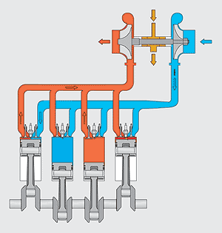
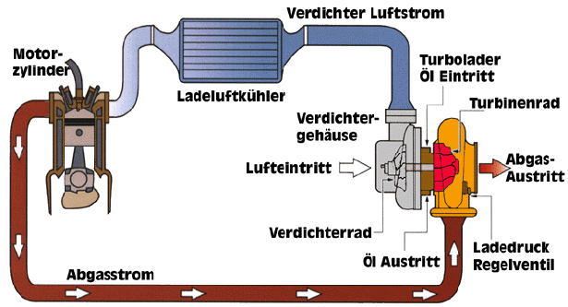
Internal Combustion Engines
Turbocharged engine

Slide 26
Internal Combustion Engines
Wankel rotary engine
Advantages:
higher power output
no reciprocating mass
simpler and lighter construction
Drawbacks:
increased wear of rubbing parts
higher fuel consumption
requirement for better materials

Slide 27
THANK YOU

