Slide 1
BANGLADESH TECHNICAL EDUCATION BOARD
DIPLOMA IN ENGINEERING
POWER TECHNOLOGY
4 th semester
Subject: IC Engine Details (27141)
Md. Naimur rahman
JUNIOR INSTRUCTOR
POWER TECHNOLOGY
Sylhet polytechnic institute, stlhet
Lesson 01

Slide 2
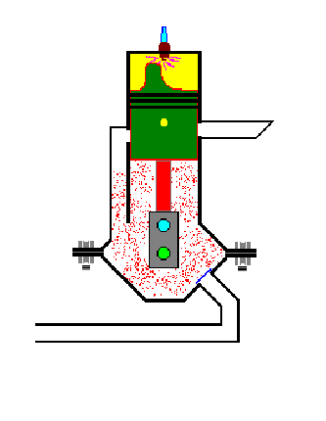
Dimension of IC engines

Slide 3
POWER PRODUCING DEVICES
I.C. ENGINE
FOUR STROKE PETROL & DIESEL ENGINE TWO STROKE PETROL & DIESEL ENGINE
TURBINE
IMPULSE REACTION
BOILERS

Slide 4
I.C. ENGINE
ENGINE
Mechanical device which converts one form of energy into another form
I.C. ENGINE
Engine in which combustion take place inside engine cylinder is called IC engine. E.g.-Aircraft engine, Automobile Engines

Slide 5
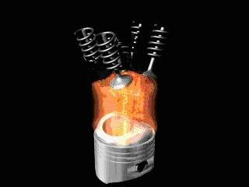
I.C. ENGINE

Slide 6
CLASSIFICATION OF I.C. ENGINE
1. CYCLE OF OPERATION
Two stroke engine
Four stroke engine
THERMODYNAMIC CYCLE
Otto cycle Diesel cycle Dual cycle
METHOD OF IGNITION
S.I. ENGINE C,I. ENGINE
NO. OF CYLINDERS
Single Multi
COOLING SYSTEM
Air cooled Water cooled Oil cooled
◉
◉
◻
◉
◉
◉
◻
◉
◉
◻
◉
◉
◻
◉
◉
◉

Slide 7
CLASSIFICATION OF I.C. ENGINE
FUEL USED
Petrol
Diesel
Gas
SPEED
High speed Lows peed Medium speed
APPLICATION
Automotive engines Aircraft engines Marine application Generator sets

Slide 8
CLASSIFICATION OF I.C. ENGINE
ARRANGEMENT OF CYLINDERS
Vertical
Horizantal
V- engine
Radial engine
Opposed cylinder
Opposed piston

Slide 9
TERMINOLOGY
BORE
STROKE
TDC
BDC
CLEARENCE VOLUME
SWEPT VOLUME
COMPRESSION RATIO

Slide 10
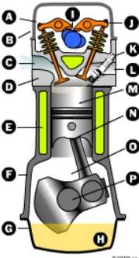
Components of Four-Stroke Engines
Camshaft
Intake Valve
Exhaust Valve
Valve Cover
Spark Plug
Intake Port
Exhaust Port
Head
Piston
Connecting Rod
Coolant
Rod Bearings
Engine Block
Crankshaft
Next
Diagram
Oil Pan
Oil Sump
Back

Slide 11
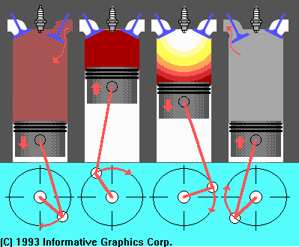
Four Stroke Cycle
10
Intake
Compression
Power
Exhaust

Slide 12
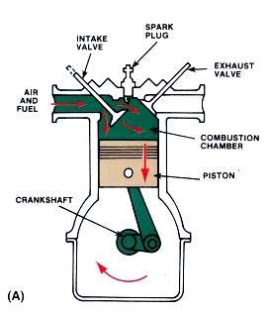
Intake Stroke
11
Intake valve opens.
Piston moves down, ½ turn of crankshaft.
A vacuum is created in the cylinder.
Atmospheric
pressure
the air/fuel
pushes mixture cylinder.
into the

Slide 13
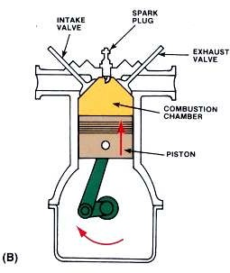
Compression Stroke
12
Valves close.
Piston moves up, ½ turn of crankshaft.
Air/fuel mixture is compressed.
Fuel starts to vaporize and heat begins to build.

Slide 14
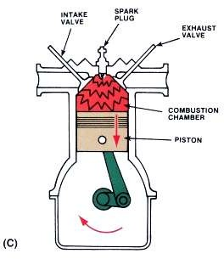
Power Stroke
13
Valves remain closed.
Spark plug fires igniting fuel mixture.
Piston moves down, ½ turn of crankshaft.
Heat is converted to mechanical energy.

Slide 15
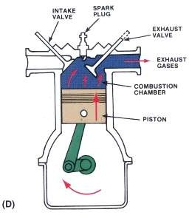
Exhaust Stroke
14
Exhaust valve opens.
Piston move up, crankshaft makes ½ turn.
Exhaust gases are pushed out polluting the atmosphere.

Slide 16
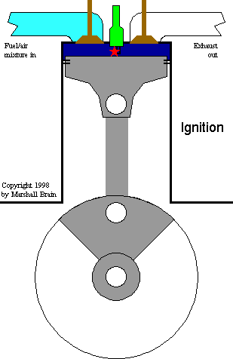
Four Stroke Cycle Animation
15

Slide 17
TWO STROKE ENGINE

Slide 18
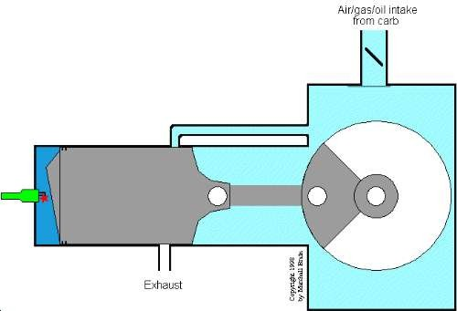
Two Stroke Animation
17

Slide 19
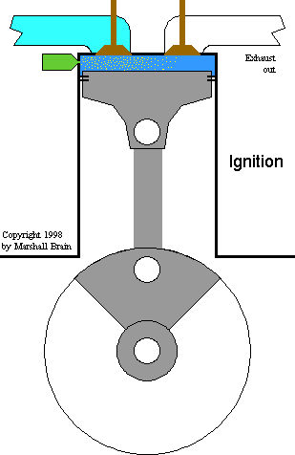
Diesel Animation
18

Slide 20
PETROL V/S DIESEL ENGINE
PETROL ENGINE (S.I.)
DIESEL ENGINE(C.I.)
Diesel cycle
Only air sucked during suction stroke
No spark plug needed
C.R.= 14-22
High efficiency
Heavy
Costly
More
Trucks,buses,gensets
Otto cycle
Air – fuel mixture suction stroke
spark plug is needed
C.R.=6-12
Low efficiency
Light weight
Cheap
Less vibration & noise
Motor cycles, cars, light duty vehicles

Slide 21
TWO STROKES V/S
FOUR STROKES
TWO STROKES
FOUR STROKES
Cycle - 1 rev & 2 strokes
1 power stroke per Rev.
Ports
Simple ,light weight , low cost
More power for same size engine
Piston shape –crown
Less efficiency
E.g, mopeds, scooters
Cycle-2rev & 4strokes
1 Power stroke per 2 Rev
valves
Complicated, heavy
, costly
Less power
Flat piston
More efficiency
Cars, bikes,trucks,buses

