Slide 1
Entropy on the Molecular Scale
Boltzmann envisioned the motions of a sample of molecules at a particular instant in time.
This would be akin to taking a snapshot of all the molecules.
He referred to this sampling as a microstate of the thermodynamic system.

Slide 2
Entropy on the Molecular Scale
Each thermodynamic state has a specific number of microstates, W, associated with it.
Entropy is
S = k lnW
where k is the Boltzmann constant, 1.38 × 10⁻²³ J/K.

Slide 3
Entropy on the Molecular Scale
Implications:
• more particles
-> more states -> more entropy
• higher T
-> more energy states -> more entropy
• less structure (gas vs solid)
-> more states -> more entropy

Slide 4
Entropy on the Molecular Scale
The number of microstates and, therefore, the entropy tends to increase with increases in
Temperature.
Volume (gases).
The number of independently moving molecules.

Slide 5
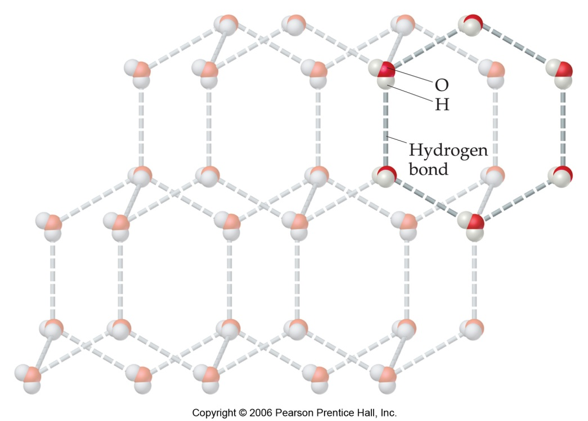
Entropy and Physical States
Entropy increases with the freedom of motion of molecules.
Therefore,
S(g) > S(l) > S(s)

Slide 6
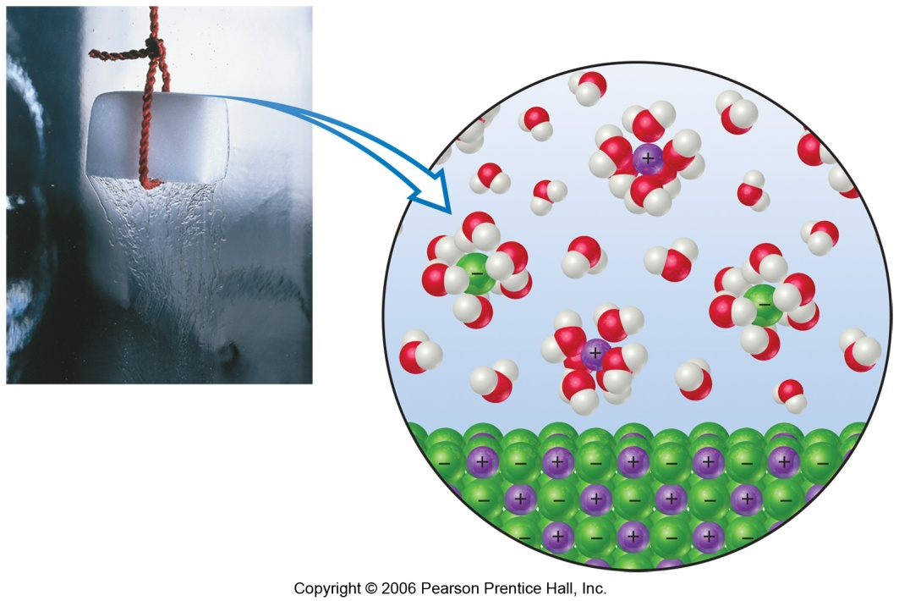
Solutions
Dissolution of a solid:
Ions have more entropy (more states)
But,
Some water molecules have less entropy (they are grouped around ions).
Usually, there is an overall increase in S.
(The exception is very highly charged ions that make a lot of water molecules align around them.)

Slide 7
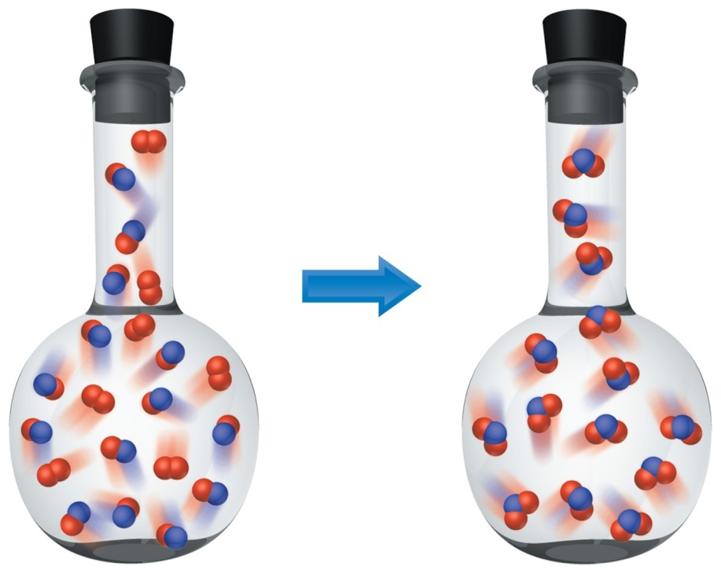
Entropy Changes
In general, entropy increases when
Gases are formed from liquids and solids.
Liquids or solutions are formed from solids.
The number of gas molecules increases.
The number of moles increases.

