Slide 1
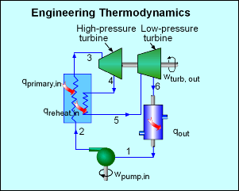
Engineering Thermodynamics
Aslam Bayzeed
Junior Instructor (Tech/power)

Slide 2
Thermodynamics
The first law of thermodynamics

Slide 3
Thermodynamics
Thermodynamics is the study of the inter-relation between heat, work and internal energy of a system and its interaction with its environment..
Example systems
Gas in a container
Magnetization and demagnetization
Charging & discharging a battery
Chemical reactions
Thermocouple operation
System
Environment
Universe

Slide 4
Thermodynamics States
A state variable describes the state of a system at time t, but it does not reveal how the system was put into that state.
Examples of state variables:
P = pressure (Pa or N/m²),
T = temperature (K),
V = volume (m³),
n = number of moles, and
U = internal energy (J).
Notes:
Could incorporate personal response system questions from the College Physics by G/R/R 2E ARIS site (www.mhhe.com/grr), Instructor Resources: CPS by eInstruction, Chapter 15, Questions 2 and 18.

Slide 5
The First Law of Thermodynamics
The first law of thermodynamics says the change in internal energy of a system is equal to the heat flow into the system plus the work done on the system (conservation of energy).
Notes:
Could incorporate personal response system questions from the College Physics by G/R/R 2E ARIS site (www.mhhe.com/grr), Instructor Resources: CPS by eInstruction, Chapter 15, Questions 1 and 8.

Slide 6
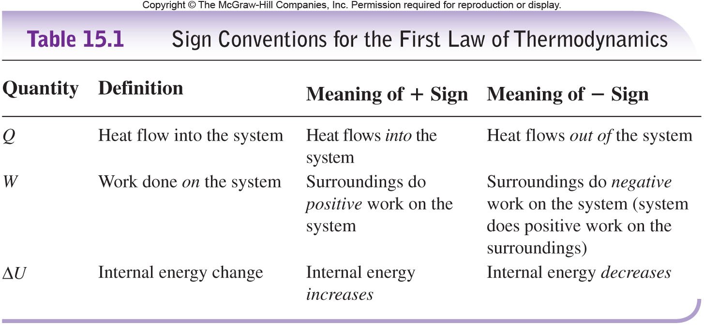
Sign Conventions

Slide 7
Sign Conventions

